Slide 1
OOP152 – OBJECT-ORIENTED PROGRAMMING
2024

Slide 2
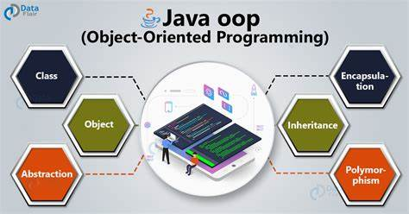
Object-oriented programming (oop152)

Slide 3
Access: Books / Eclipse ide / MS office…etc.

Slide 4
PRESCRIBED Textbook
Think Java: How to Think Like a Computer Scientist Downey, A.B. and Mayfield, C. (2019) Version 6.1.3

Slide 5
TOPIC 4 • Representations of arrays of objects and objects of arrays

Slide 6
Object Representations and Design Principles
OUTLINE
Objects of Arrays
The Deck Class
Shuffling Decks
Selection Sort
Merge Sort
Sub decks
Merging decks

Slide 7
the deck class

Slide 8
Object Representations and Design Principles
Objects of Arrays
Main Concept
Create a Deck class that encapsulate and array of Card objects.
Class serves as a container for multiple Card instances.

Slide 9
Object Representations and Design Principles
Objects of Arrays
Initial Class Definition
The Deck class starts with an array of Card objects as a private instance variable.
public class Deck {
private Card[] cards;
public Deck(int n) {
this.cards = new Card[n];
}
}
The constructor initializes the array to hold n cards, but does not create the Card objects yet.

Slide 10
Object Representations and Design Principles
Objects of Arrays
Extended Constructor for a Standard Deck:
A second constructor is added to create a standard 52-card deck and populate it with Card objects.
public Deck() {
this.cards = new Card[52];
int index = 0;
for (int suit = 0; suit <= 3; suit++) {
for (int rank = 1; rank <= 13; rank++) {
this.cards[index] = new Card(rank, suit);
index++;
}
}
}

Slide 11
Object Representations and Design Principles
Objects of Arrays
Instance Method to Print the Deck:
Converts the static printDeck method from a previous section to an instance method that prints all cards in the deck.
public void print() {
for (int i = 0; i < this.cards.length; i++) {
System.out.println(this.cards[i]);
}
}
This method allows for easier invocation on Deck objects, simplifying to deck.print().

Slide 12
Shuffling decks

Slide 13
Object Representations and Design Principles
Objects of Arrays
Human Shuffling: Typically involves dividing the deck in two and alternately choosing cards from each half:
Not perfectly random due to human error.
Perfect shuffles can cycle back to the original order after eight iterations.

Slide 14
Object Representations and Design Principles
Objects of Arrays
Human Shuffling: Code:
void shuffleDeck(Card[] deck) {
Random rand = new Random();
for (int i = 0; i < deck.length; i++) {
int r = i + rand.nextInt(deck.length - i);
Card temp = deck[i];
deck[i] = deck[r];
deck[r] = temp;
}
}

Slide 15
Object Representations and Design Principles
Objects of Arrays
Human Shuffling: Helper Methods Needed
randomInt(int low, int high): Returns a random integer between low and high.
swapCards(int index1, int index2) Swaps cards at the specified indices.

Slide 16
Object Representations and Design Principles
Objects of Arrays
Selection Sort:
Objective: Sort a deck of cards in order.
Algorithm: Selection sort, which selects the lowest (or highest) card during each iteration.

Slide 17
Object Representations and Design Principles
Objects of Arrays
Selection Sort: Code
void selectionSort(Card[] deck) {
for (int i = 0; i < deck.length - 1; i++) {
int indexLowest = i;
for (int j = i + 1; j < deck.length; j++) {
if (deck[j].compareTo(deck[indexLowest]) < 0) {
indexLowest = j;
}
}

Slide 18
Object Representations and Design Principles
Objects of Arrays
Selection Sort: Code
// Swap the lowest card with the card at index i
Card temp = deck[i];
deck[i] = deck[indexLowest];
deck[indexLowest] = temp;
}
}

Slide 19
Object Representations and Design Principles
Objects of Arrays
Selection Sort: Helper Method Needed
indexLowest(int startIndex, Card[] deck): Returns the index of the lowest card starting from startIndex.

Slide 20
Object Representations and Design Principles
Objects of Arrays
Selection Sort: Helper Method Needed
Both shuffling and sorting utilize similar operations, such as swapping elements, but achieve opposite outcomes. The shuffle randomizes the order, while sorting organizes it systematically.

Slide 21
MERGE SORT

Slide 22
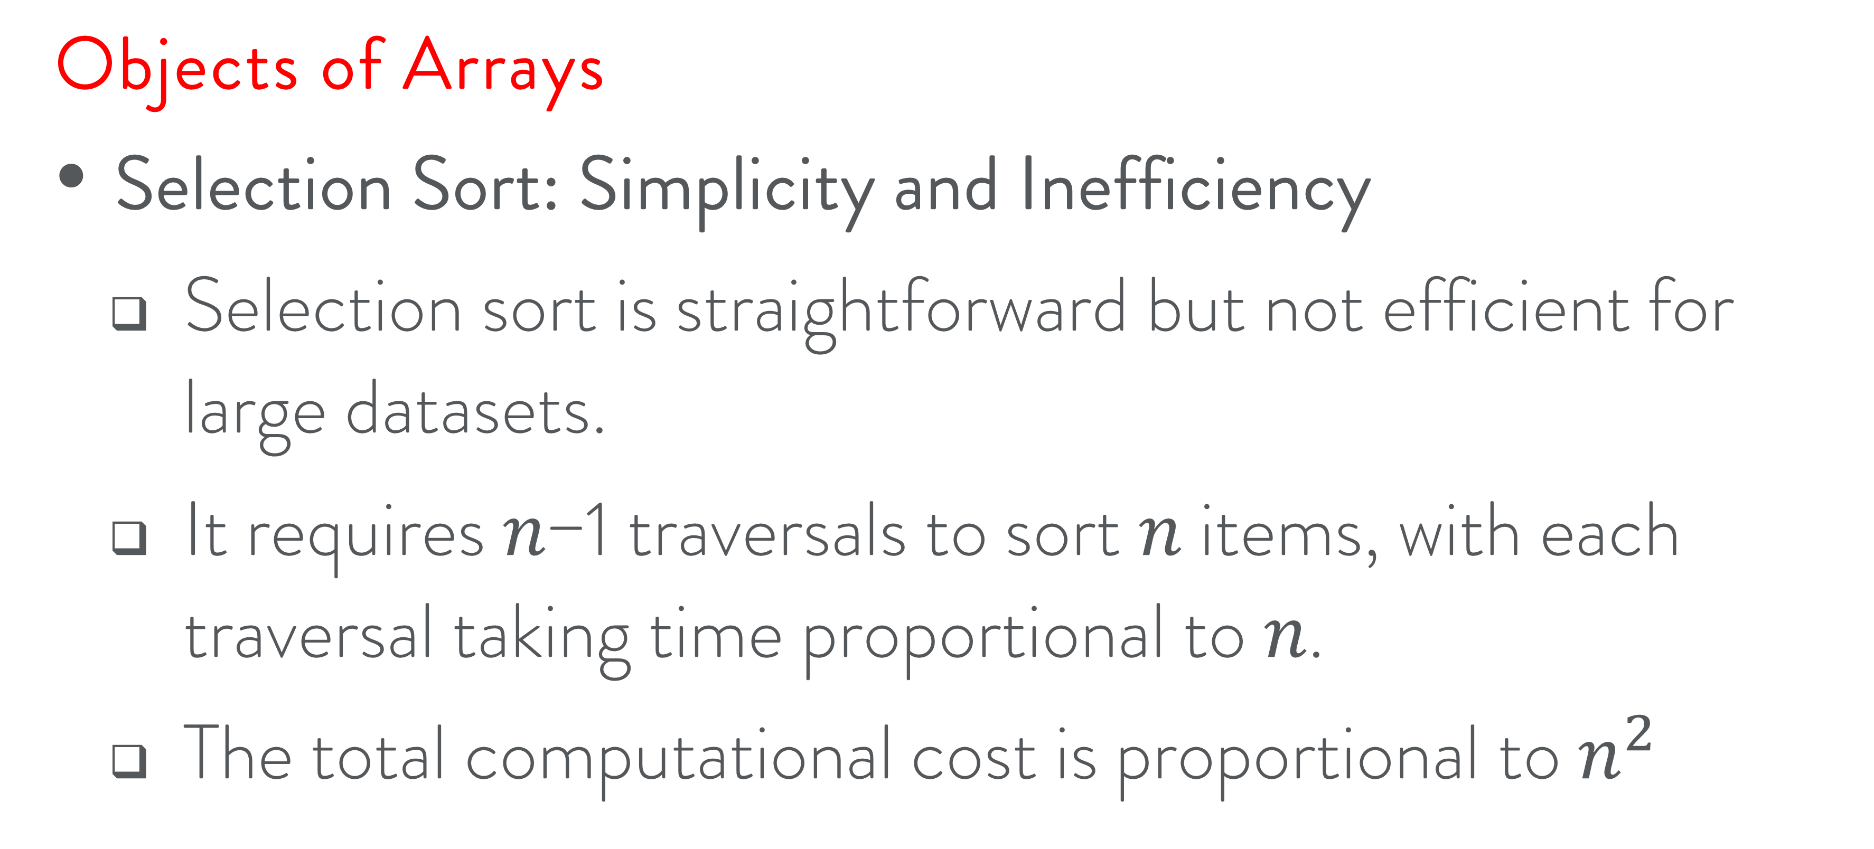
Object Representations and Design Principles
Objects of Arrays
Selection Sort: Simplicity and Inefficiency
Selection sort is straightforward but not efficient for large datasets.
It requires 𝑛−1 traversals to sort 𝑛 items, with each traversal taking time proportional to 𝑛.
The total computational cost is proportional to $n^{2}$

Slide 23
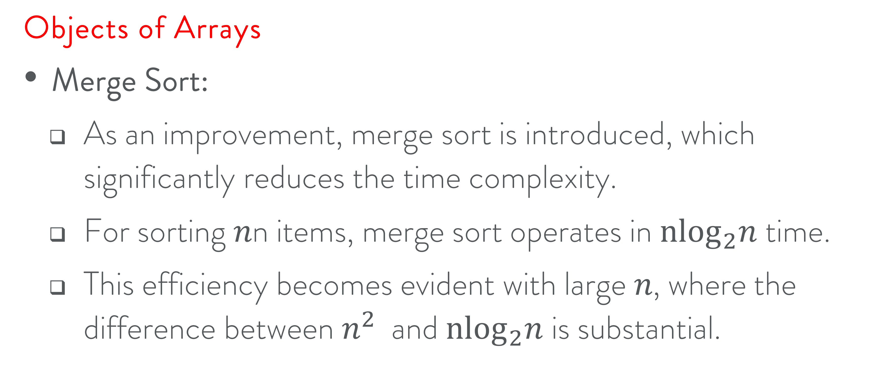
Object Representations and Design Principles
Objects of Arrays
Merge Sort:
As an improvement, merge sort is introduced, which significantly reduces the time complexity.
For sorting 𝑛n items, merge sort operates in ${nlog}_{2}n$time.
This efficiency becomes evident with large 𝑛, where the difference between $n^{2}$ and ${nlog}_{2}n$is substantial.

Slide 24
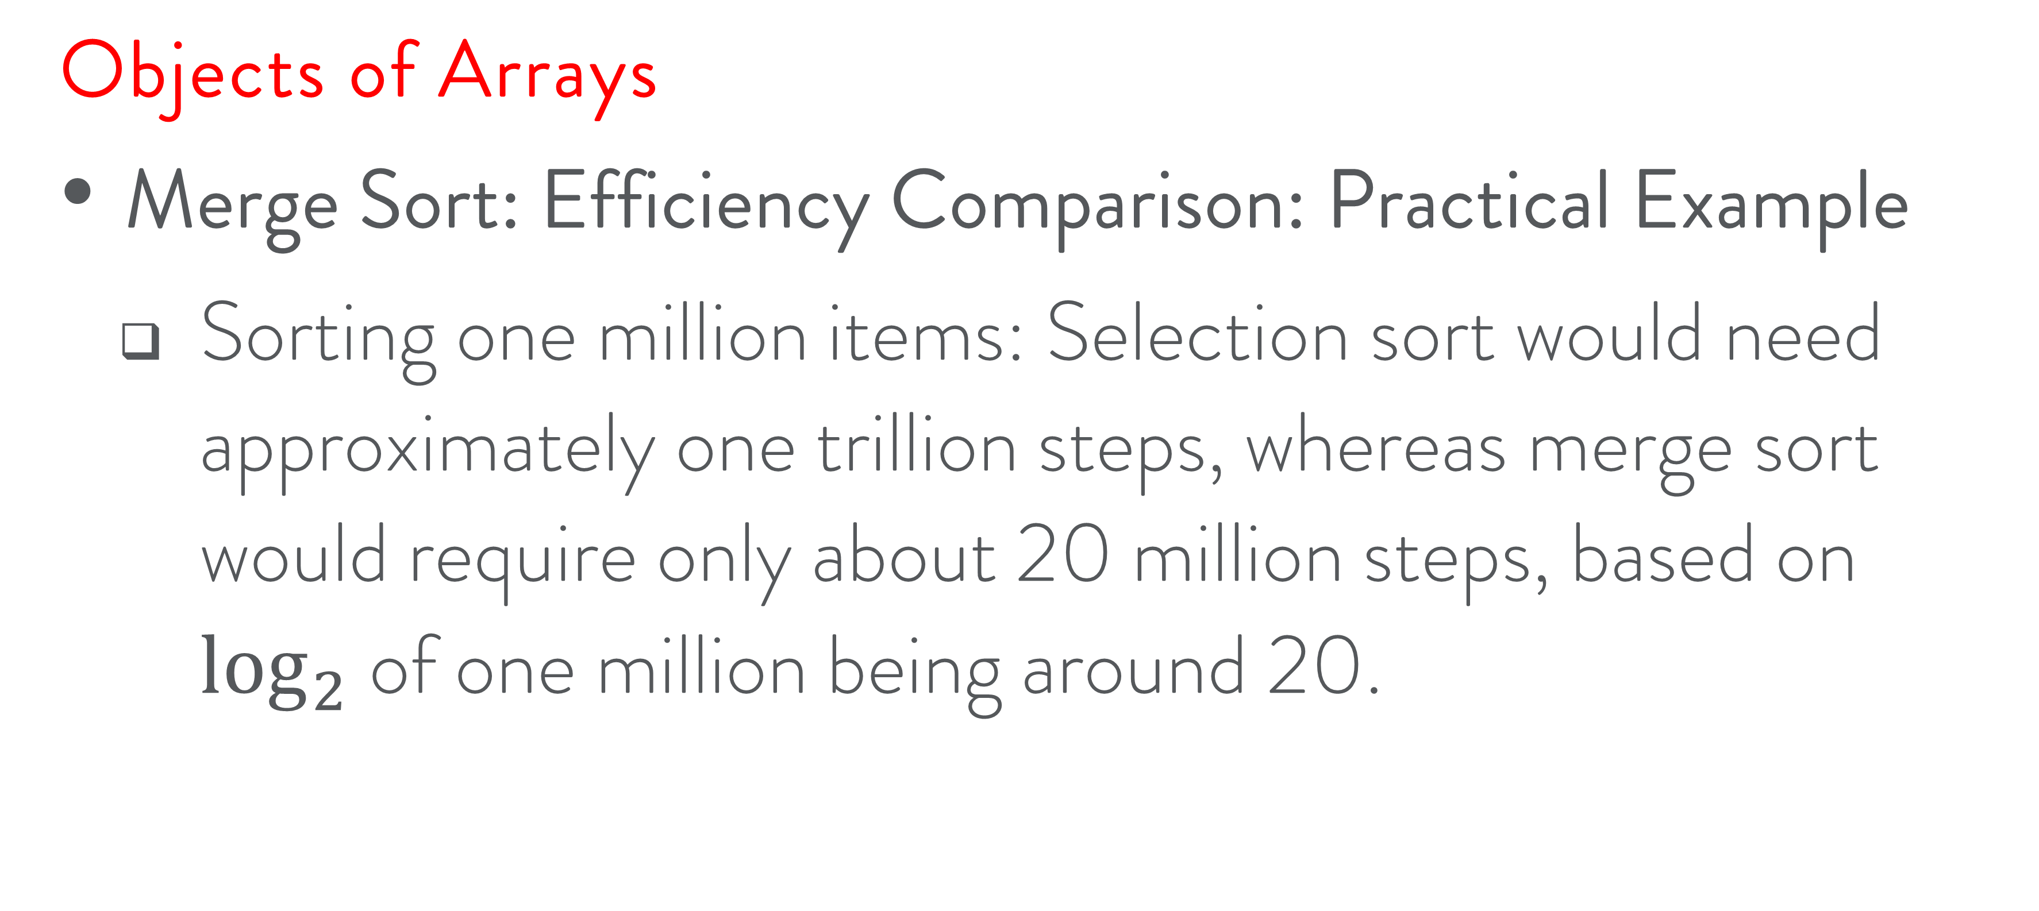
Object Representations and Design Principles
Objects of Arrays
Merge Sort: Efficiency Comparison: Practical Example
Sorting one million items: Selection sort would need approximately one trillion steps, whereas merge sort would require only about 20 million steps, based on $\log_{2}$of one million being around 20.

Slide 25
Object Representations and Design Principles
Objects of Arrays
Merging Sorted Subdecks:
The core idea is that merging two sorted sublists (subdecks) is efficient and straightforward.
Example with cards:
Divide the deck into two sorted subdecks.
Merge them by repeatedly comparing and selecting the lower of the two top cards until all cards are merged into a single sorted deck.

Slide 26
Object Representations and Design Principles
Objects of Arrays
Merging Sorted Subdecks: Java Code
public class MergeSort {
public static void mergeSort(int[] array, int[] temp, int leftStart, int rightEnd) {
if (leftStart >= rightEnd) {
return;
}
int middle = (leftStart + rightEnd) / 2;
mergeSort(array, temp, leftStart, middle);
mergeSort(array, temp, middle + 1, rightEnd);
mergeHalves(array, temp, leftStart, rightEnd);
}

Slide 27
Object Representations and Design Principles
Objects of Arrays
Merging Sorted Subdecks: Java Code
public static void mergeHalves(int[] array, int[] temp, int leftStart, int rightEnd) {
int leftEnd = (rightEnd + leftStart) / 2;
int rightStart = leftEnd + 1;
int size = rightEnd - leftStart + 1;
int left = leftStart;
int right = rightStart;
int index = leftStart;

Slide 28
Object Representations and Design Principles
Objects of Arrays
Merging Sorted Subdecks: Java Code
while (left <= leftEnd && right <= rightEnd) {
if (array[left] <= array[right]) {
temp[index] = array[left];
left++;
} else {
temp[index] = array[right];
right++;
}
index++;
}

Slide 29
Object Representations and Design Principles
Objects of Arrays
Merging Sorted Subdecks: Java Code
System.arraycopy(array, left, temp, index, leftEnd - left + 1);
System.arraycopy(array, right, temp, index, rightEnd - right + 1);
System.arraycopy(temp, leftStart, array, leftStart, size);
}

Slide 30
Object Representations and Design Principles
Objects of Arrays
Merging Sorted Subdecks: Java Code
public static void main(String[] args) {
int[] array = {34, 7, 23, 32, 5, 62};
int[] temp = new int[array.length];
mergeSort(array, temp, 0, array.length - 1);
for (int i : array) {
System.out.println(i);
}
}
}

Slide 31
Object Representations and Design Principles
Objects of Arrays
Merging Sorted Subdecks: Explanation
The mergeSort function recursively divides the array into halves until the subarrays have only one element.
mergeHalves function merges these halves in a sorted order.
The main method showcases a simple usage of merge sort on a small array of integers.

Slide 32
Subdeck

Slide 33
Object Representations and Design Principles
Objects of Arrays
Subdeck Method
The subdeck method is used to split a deck into two subdecks, each containing roughly half of the original cards.

Slide 34
Object Representations and Design Principles
Objects of Arrays
Subdeck Method
The method, subdeck, takes two parameters: low and high, which define the range of indexes in the deck.
It returns a new deck that includes the cards within the specified range.

Slide 35
Object Representations and Design Principles
Objects of Arrays
Subdeck Method: Code
public Deck subdeck(int low, int high) {
Deck sub = new Deck(high - low + 1);
for (int i = 0; i < sub.cards.length; i++) {
sub.cards[i] = this.cards[low + i];
}
return sub;
}

Slide 36
Merging deck

Slide 37
Object Representations and Design Principles
Objects of Arrays
Merge Method Algorithm:
Create a new deck to hold all the cards from both subdecks, d1 and d2.
Initialize indices:
i for the current position in the first subdeck, d1.
j for the current position in the second subdeck, d2.

Slide 38
Object Representations and Design Principles
Objects of Arrays
Merge Method Algorithm:
Iterate over each position k in the resulting deck:
Check if a subdeck is empty:
If d1 is empty, add the remaining cards from d2.
If d2 is empty, add the remaining cards from d1.

Slide 39
Object Representations and Design Principles
Objects of Arrays
Merge Method Algorithm:
Compare cards from both decks if neither are empty.
Add the smaller card to the new deck at position k.
Increment the index (i or j) of the subdeck from which the card was taken.
Return the new, merged deck.

Slide 40
Object Representations and Design Principles
Objects of Arrays
Merge Method Algorithm: Code
public class Deck {
Card[] cards; // Assume Card is a predefined class that has a comparison method
public Deck(int n) {
cards = new Card[n];
}

Slide 41
Object Representations and Design Principles
Objects of Arrays
Merge Method Algorithm: Code
public static Deck merge(Deck d1, Deck d2) {
Deck result = new Deck(d1.cards.length + d2.cards.length);
int i = 0, j = 0;

Slide 42
Object Representations and Design Principles
Objects of Arrays
Merge Method Algorithm: Code
for (int k = 0; k < result.cards.length; k++) {
if (i >= d1.cards.length) { // d1 is empty
result.cards[k] = d2.cards[j++];
} else if (j >= d2.cards.length) { // d2 is empty

Slide 43
Object Representations and Design Principles
Objects of Arrays
Merge Method Algorithm: Code
result.cards[k] = d1.cards[i++];
} else if (d1.cards[i].compareTo(d2.cards[j]) <= 0) { // d1 has the smaller card
result.cards[k] = d1.cards[i++];
} else { // d2 has the smaller card or they are equal
result.cards[k] = d2.cards[j++];
}
}
return result;
}
}

Slide 44



